Slide 1
Pythagoras's Theorem
Miss L
Year 12

Slide 2

Learning Intentions
WICOR
Students will be able to
Calculate the hypotenuse using Pythagoras Theorem

Slide 3
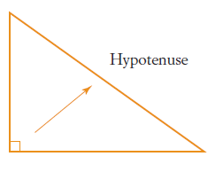
24
7
30
Trigonometry
Date:
EQ – What is Pythagoras Theorem and how do we use it?
A right-angled triangle has one angle measuring 90° and two smaller angles. The side opposite the right angle is the longest side.
That is called the hypotenuse.
What is the hypotenuse?

Slide 4
Practice
c
hypotenuse
hypotenuse
c
a
b
hypotenuse
b
a
c
b
a
Which of these sides is the hypotenuse?

Slide 5


Slide 6
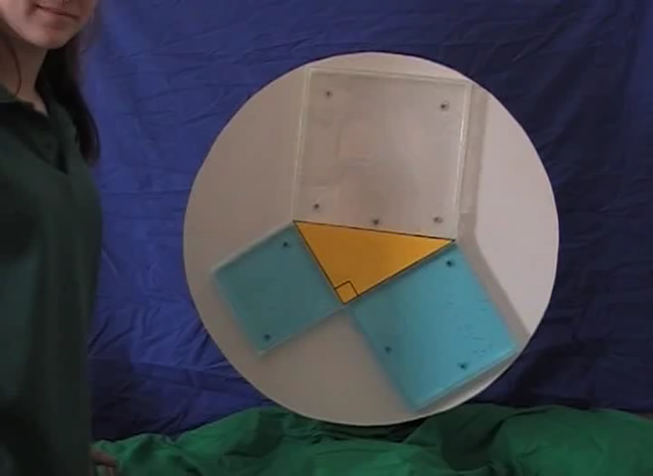

Slide 7
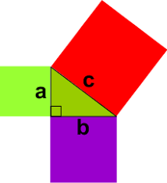
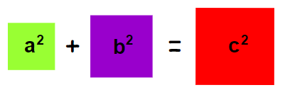
24
7
30
Trigonometry
Date:
EQ – What is Pythagoras Theorem and how do we use it?
What Pythagoras Theorem?
For any right-angled triangle, the square of the hypotenuse is equal to the sum of the squares of the other two sides.

Slide 8
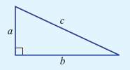
Summarise
a² + b² = c²
shorter sides longer side (hypotenuse)

Slide 9



Practice
Find the length of the hypotenuse for these:
a) b)

Slide 10
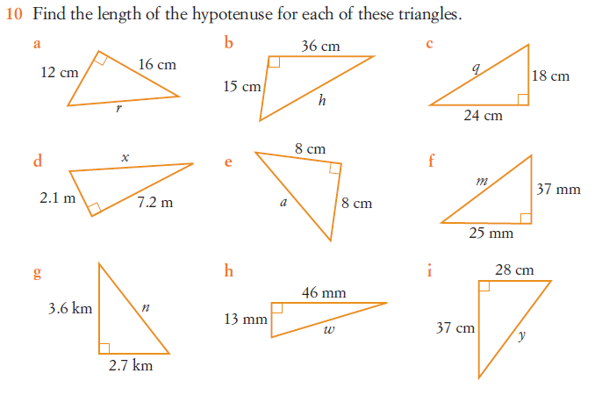
Task

Slide 11
Extra graphics

